Slide 1
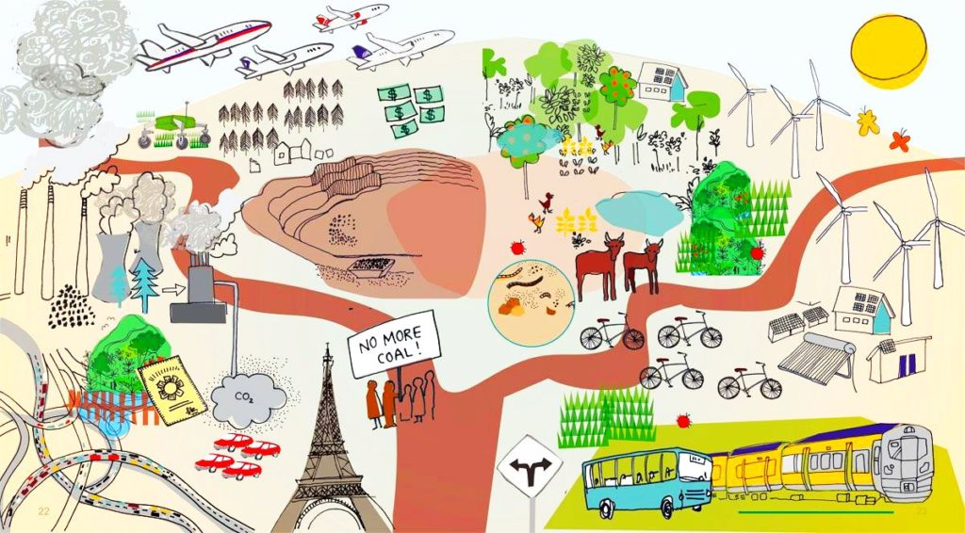
Sustainable Communities
Sustainability – Doing More With Less

Slide 2
Format of Talk
Introduction
Sustainability ~ Waste Hierarchy ~ Circular Economy ~ SDGs
Look back on 2018
Key waste & resource issues
TidyTowns consultation
Results
What can WE do?
Application ~ Recycling ~ Reuse ~ Repair ~ Food ~ Organics ~ Fast Fashion ~ Shop Local ~ Energy ~ Water ~ Travel

Slide 3
Sustainability - Doing More With Less
Living Better Using Less
Less Impact
Less Resources
Less Need
Less Waste
Less Hazard
More Information
More Recovery/Reuse
More Eco-efficient
More Sustainable
More Thought

Slide 4
Waste Hierarchy

Slide 5
Circular Economy
Notes:
We have become consumers and not citizens

Slide 6
Sustainability

Slide 7
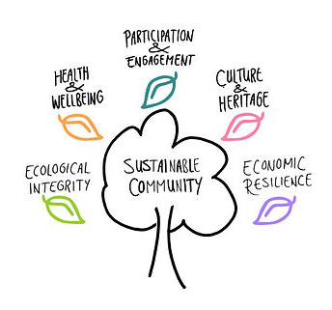
Sustainability
www.sustinabletoolkit.ie

Slide 8
Sustainable Development Goals
www.sdgsforall.ie
Notes:
.

Slide 9
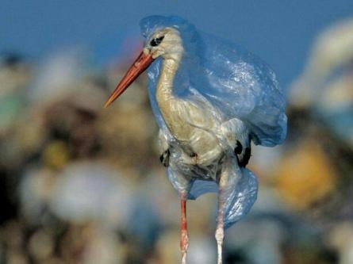
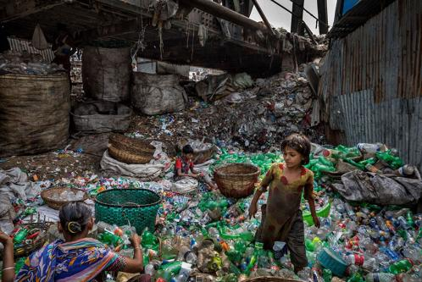
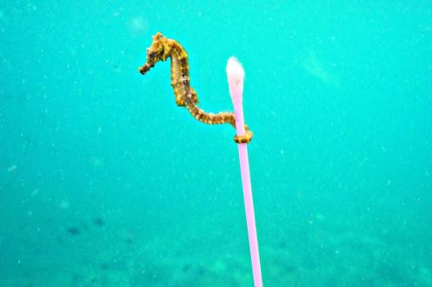
Got to look back to move forward
Blue Planet
IPCC report – We have limited time

Slide 10
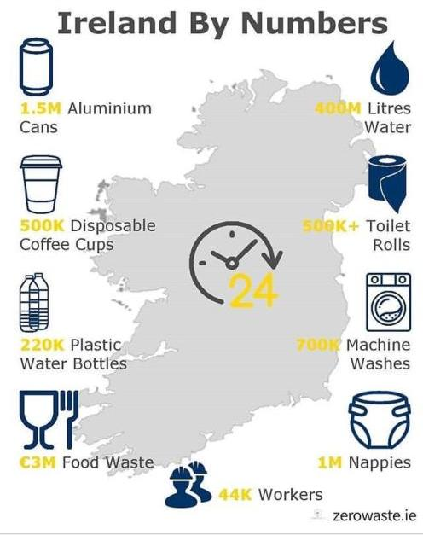
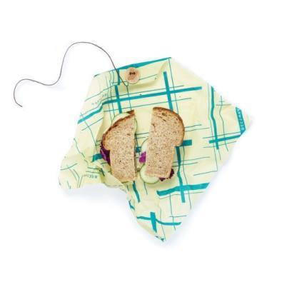
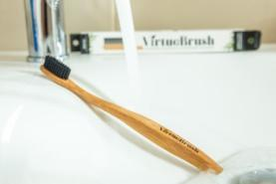
Got to look back to move forward
Purpose is back – use it to your advantage
Community activism is growing
We need to take bold steps
Little steps help

Slide 11
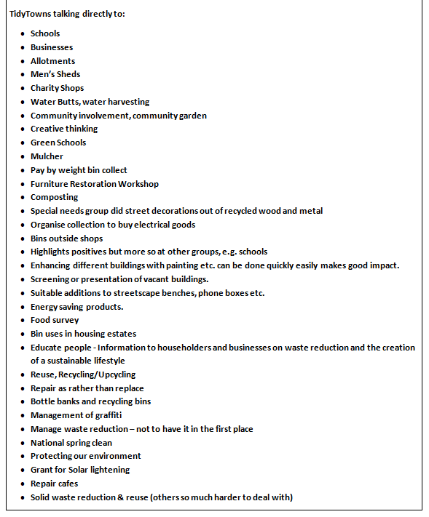
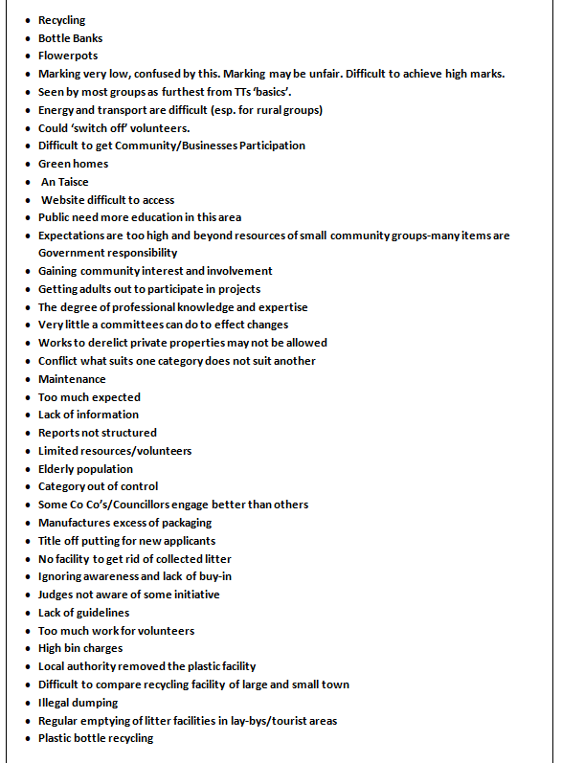
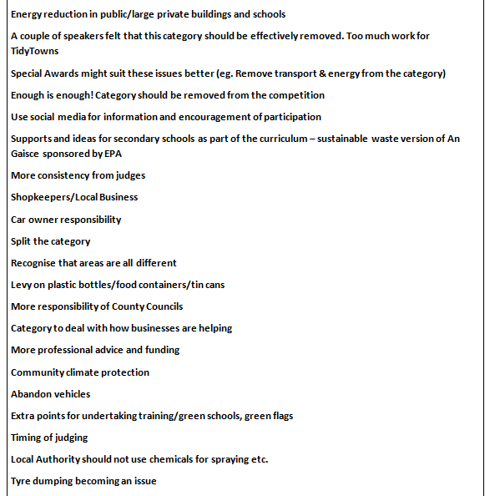
TidyTowns Consultation
What do you think?
What does not work?
Is there anything else you would like incorporated?

Slide 12
Results – Sustainability
Low scoring category
Ever evolving competition category

Slide 13
Results
 | Dublin | Kildare | Laois | Longford | Louth | Meath | Offaly | Westmeath | Wicklow
Lowest Mark | 8 | 8 | 7 | 9 | 6 | 8 | 11 | 6 | 5
Highest Mark | 26 | 22 | 25 | 20 | 21 | 23 | 23 | 19 | 23
 | Cabinteely | Rathangan Leixlip | Abbeyleix | Longford | Blackrock Dundalk | Ratoath | Geashill | Ballinahown | Blessington

Slide 14
What can WE do?
Communicate
Facebook
Twitter
Instagram
Blog etc.
Encourage
Support
Sing Your Own Praises
Raise your local profile
Local Councillors
Organise
Collaborate
Facilitate

Slide 15
Tús maith, leath na hoibre
Print double sided!
Provide detail on application form
Tell YOUR involvement
Measurement
Attendance
Facebook likes, shares, Twitter likes, Local paper readership
Feedback from attendees

Slide 16
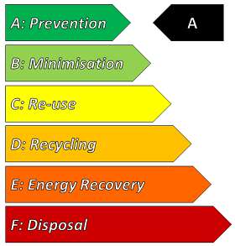
Prevention

Slide 17
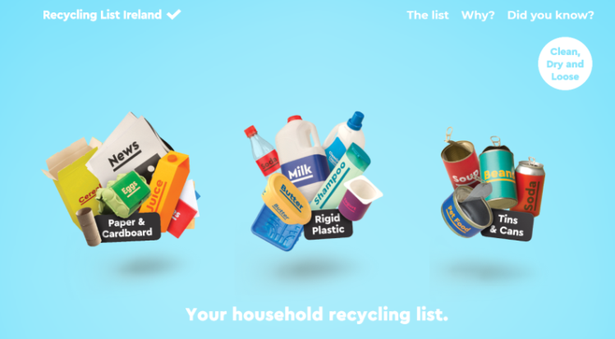
Recycling

Slide 18
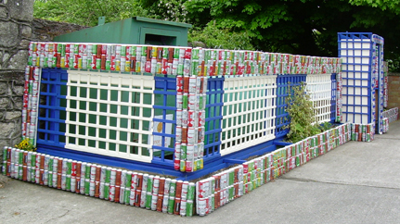
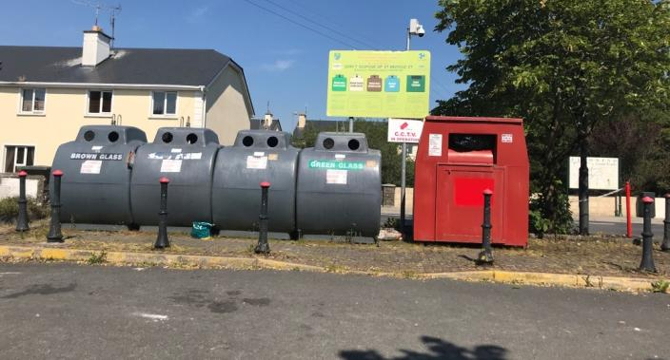
Recycling
Facilities clean & inviting to encourage usage

Slide 19
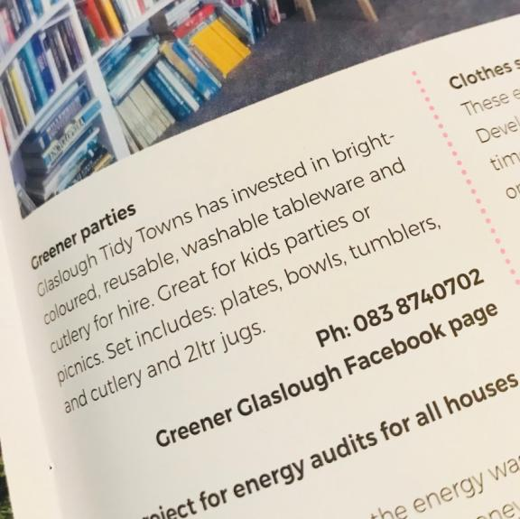
Reuse
Share
Book Box, Free Libraries
Organise a platform for sharing baby clothes and equipment
Events
Swap event for uniforms, sports gear, tools, toys, clothes
Bring & Buy sale
Greener parties
Competitions
Organise an upcycling competition
Competition to create items from reused materials

Slide 20
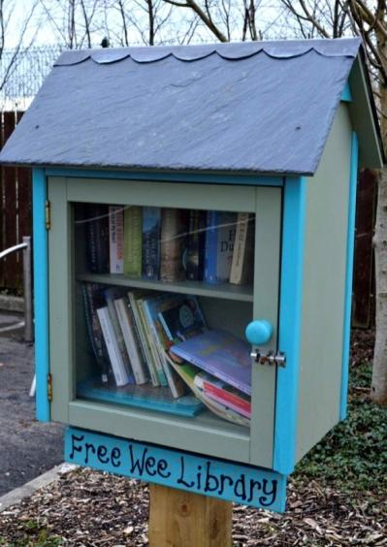
Reuse
Buy nothing new Christmas!
EBay~ Free Trade Ireland
Library of things – tools, plants or other items for sharing with the community
Hold a Pass It On Week

Slide 21
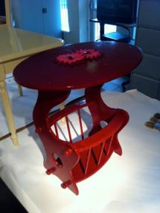
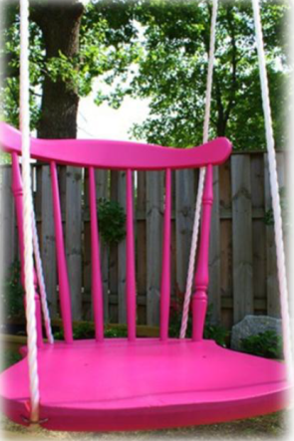
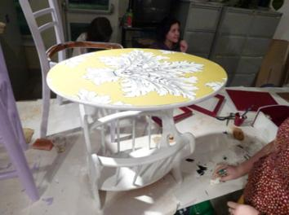
Upcycling
Before

Slide 22
Repair #MakeThingsLast
Repair My Stuff.ie
Workshops & Skills development
Respraying, furniture restoration, upcycled furniture, refinishing
Rediscovery Centre & ReCreate offer courses
Repair Guide
List local repair outlets
Bike Repair
Repair Cafes
Repair Friday

Slide 23
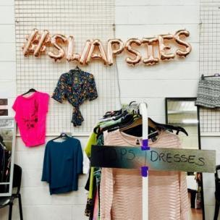
Fast Fashion
#LoveYourClothes

Slide 24
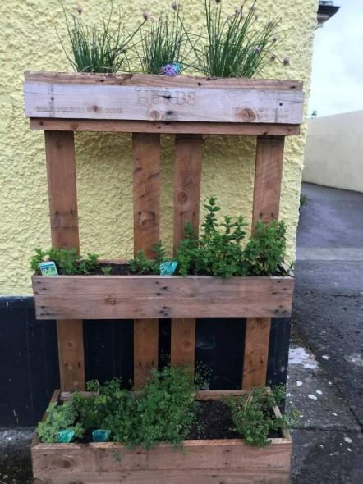
Food
Veganuary
Vegetarian/flexitarian/vegan diets
Meet Free Mondays
StopFoodWaste Challenge
Cooking lessons
Cooking demonstrations
Better buying and better storage

Slide 25
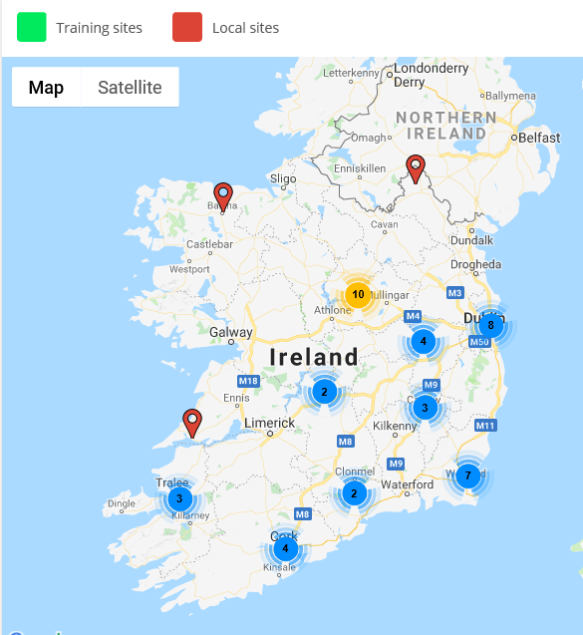
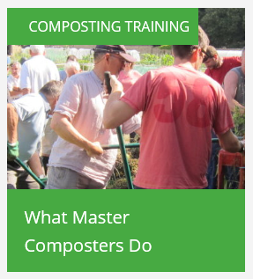
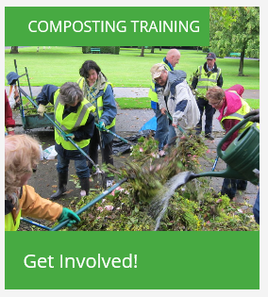
Organics
Master Composter
Composting demonstration sites

Slide 26
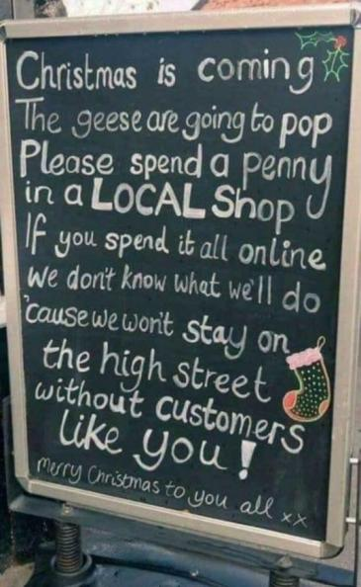
Shop Local
Environmental benefits, supporting local jobs, businesses reinvest into community

Slide 27
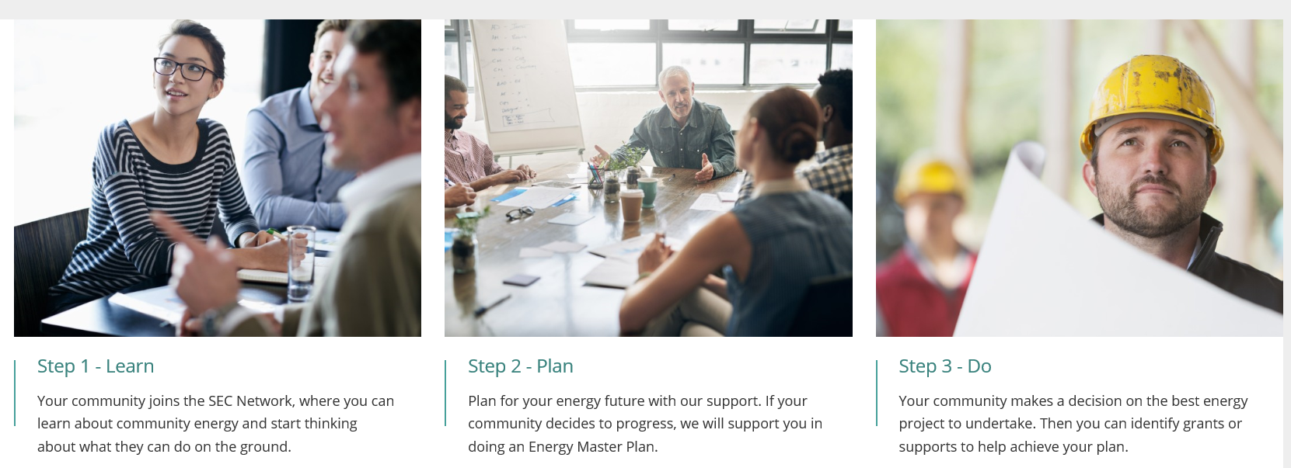
Energy
SEAI – Sustainable Energy Communities

Slide 28
Energy
Energy saving measures
Understanding the bills
Standby
Switch to LED
Battery Recycling
Village Lighting
Earth Hour

Slide 29
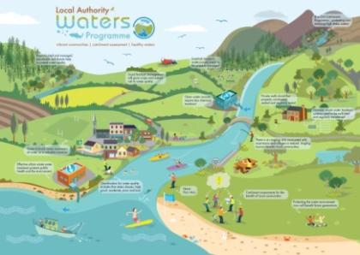
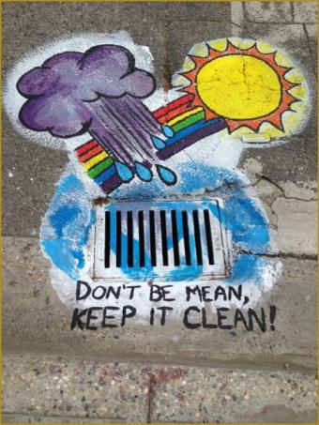
Water

Slide 30
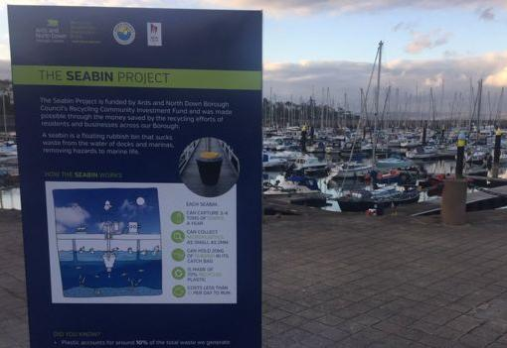
Sea Bin Project

Slide 31
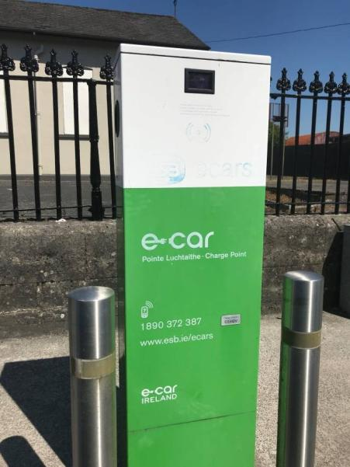
Smarter Travel
Promotion of car sharing
Electric vehicles
Charge points
WOW / COW
Cycle Bus

Slide 32
Stakeholder Involvement
Local Authority
Local Businesses
Green Schools
Scouts / Cubs
Public Library
Festival & Event Committees
Local Development Organisations
Sporting Organisations
ICA / Men’s Shed
Charity & Repair Shops
Community Centre
Anyone who is interested!

Slide 33
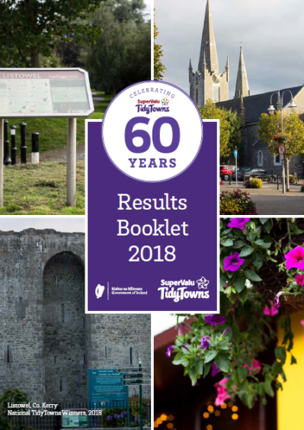
A look at Listowel – 2018
Carbon neutral Listowel
Energy audits of businesses
Eco friendly cleaning products
Conscious cup campaign
Community composter
3-year waste management plan

Slide 34
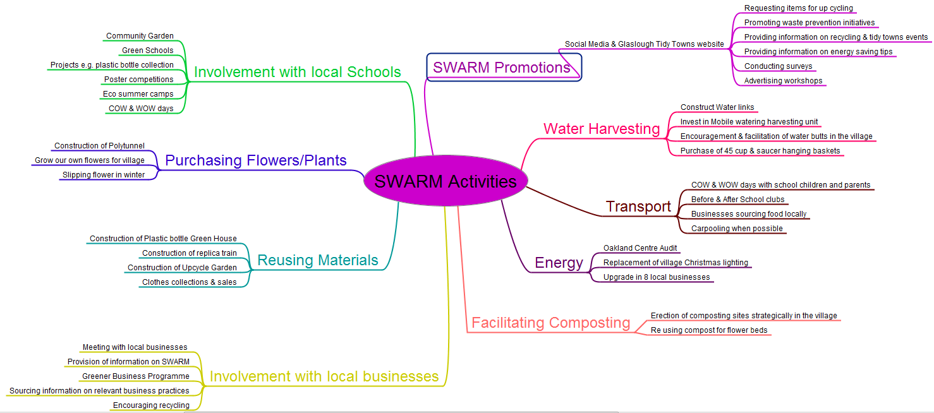
Glaslough TidyTowns

Slide 35
Example Application for 2019:
Dates | Actions | Details
September 18 | School liaison officer met with X No. schools in relation to their progress for Green Schools Programme | How do you measure your success and convey this to the adjudicator: - Provide clear and concise details here in relation to numbers in attendance of events, number of likes, number of views, paper readership numbers. - Use feedback forms - Participation rates - Monitoring the action can be a good tool for you to publicise the success of your action
October 18 | Met with businesses and requested information in relation to EMS savings, Green Hospitality savings, environmental initiatives
November 18 | Promotion of EWWR 2018 Promotion of shop locally and sustainable Christmas gift via Facebook & Twitter
December 18 | Promotion of Christmas Card reuse and recycling via Facebook and Twitter Real Christmas Tree Recycling promoted
January 19 | Promotion of water saving tips via Parish Notes/Article in local press – (See Press Cut Out in Appendix)
February 19 | Attended TidyTowns Conference School or Business event
March 19 | Earth Hour participation
April 19 | Large community event - cooking demonstration, stitch and style event
May 15 | TidyTowns sustainable House-keeping throughout the year

